Slide 1
COMPLAINT TRACKER
A Java-Based Complaint Management System using Data Structures & Algorithms
PROJECT TEAM
G. Sri Ram
Reg. No: 2520030218
B. Chandrika
Reg. No: 2520030047
G. B. Vedaditya
Reg. No: 2520030481
Project Title | Complaint Tracker

Slide 2
Abstract
The Complaint Tracker System is a Java-based application built to efficiently manage and track customer complaints within an organization. It allows users to register complaints, search records, update complaint status, and view complaint details in an organized way.
KEY DSA CONCEPTS
ArrayList
Dynamic data storage
HashMap
To improve performance, the system applies Data Structures and Algorithms such as ArrayList for dynamic storage, HashMap for fast retrieval, Queue and PriorityQueue for processing complaints, and sorting/searching algorithms for efficient data handling.
Fast complaint retrieval
Queue
Sequential processing
PriorityQueue
Urgent complaint handling
By automating complaint handling, the system reduces manual effort, improves response time, and demonstrates the practical use of Java and DSA in solving a real-world problem.
Sorting & Searching
Efficient data management

Slide 3
Problem Statement
Organizations receive numerous customer complaints every day, making manual complaint management time-consuming and error-prone. As the number of complaints grows, searching, updating, and tracking records manually becomes increasingly difficult, delaying resolution and reducing service quality.
The Solution: The proposed Complaint Tracker System uses Java and Data Structures to efficiently store, search, prioritize, and manage complaints — ensuring faster processing and better organization than manual methods.
1
Growing Volume
2
Slow Retrieval
3
No Prioritization
Daily complaints pile up faster than they can be manually tracked.
Finding a specific complaint record takes too much time.
Urgent complaints get treated the same as minor ones.

Slide 4
Proposed Functionalities
1
User registration and login
2
Register new complaints with relevant details
3
View and track complaint status
4
Search complaints by Complaint ID or Customer Name
5
Update complaint details and status
6
Delete resolved or invalid complaints
7
Prioritize urgent complaints using a Priority Queue
8
Sort complaints by ID, date, or priority
9
Generate a summary of pending and resolved complaints

Slide 5
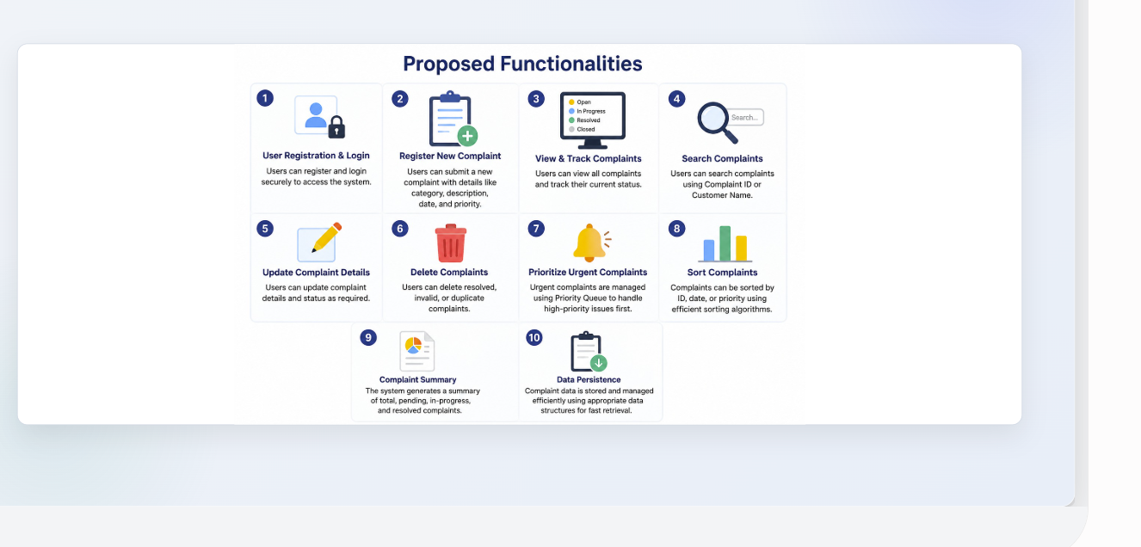

Slide 6
How It Works
Complaint flow through the system, powered by core Data Structures
Complaint
Submitted
Stored &
Indexed
Queued for
Processing
Urgent Cases
Prioritized
Resolved &
Sorted
→
→
→
→
ArrayList
HashMap
Queue
PriorityQueue
Sort / Search
Fast Access
Fair Ordering
Smart Priority
HashMap gives near-instant complaint lookup by ID.
Queue keeps complaints processed in the order received.
PriorityQueue pushes urgent complaints to the front.

Slide 7
Tools & Technologies
✓
Programming Language
Java
✓
IDE
IntelliJ IDEA / Eclipse / VS Code
✓
JDK
Java Development Kit (JDK 17 or later)
✓
Version Control
Git & GitHub
✓
Data Structures
ArrayList, HashMap, Queue, PriorityQueue
✓
Algorithms
Binary Search, Merge Sort, Quick Sort

Slide 8
Expected Outcome
The Complaint Tracker System will provide an efficient, organized way to manage customer complaints — enabling faster retrieval and prioritized handling through Java and DSA.
1
2
3
4
Register, search, update
and track complaints easily
Faster data retrieval
using HashMap
Prioritized handling
via PriorityQueue
Real-world use of
Java & DSA concepts
Complaint Tracker • G. Sri Ram | B. Chandrika | G. B. Vedaditya

Slide 9
Thank You
Complaint Tracker System
G. Sri Ram (2520030218) | B. Chandrika (2520030047) | G. B. Vedaditya (2520030481)

